Slide 1














Machine Learning
Comment
Share
File
Edit
View
Insert
Runtime
Tools
Help
All changes saved
Code
Text
Connect
$$\left\{x\right\}$$
Machine Learning Basics

Slide 2
Machine Learning
Comment
Share
File
Edit
View
Insert
Runtime
Tools
Help
All changes saved
Code
Text
Connect
What is Learning?
$$\left\{x\right\}$$
1. “Learning denotes changes in a system that ... enable a system to do the same task … more efficiently the next time.” -Herbert Simon
2. “Learning is constructing or modifying representations of what is being experienced.” -Ryszard Michalski
3. “Machine learning refers to a system capable of the autonomous acquisition and integration of knowledge.”

Slide 3
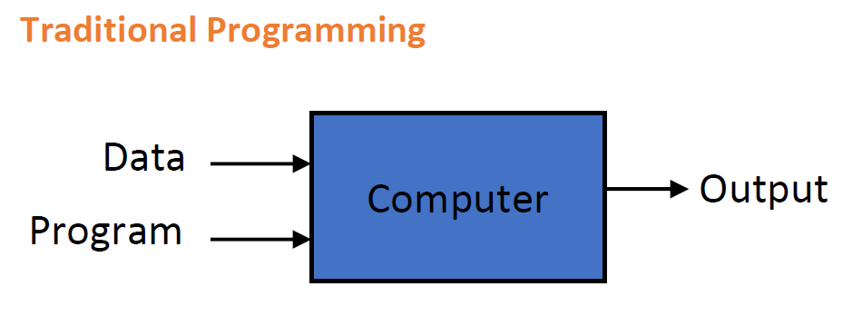
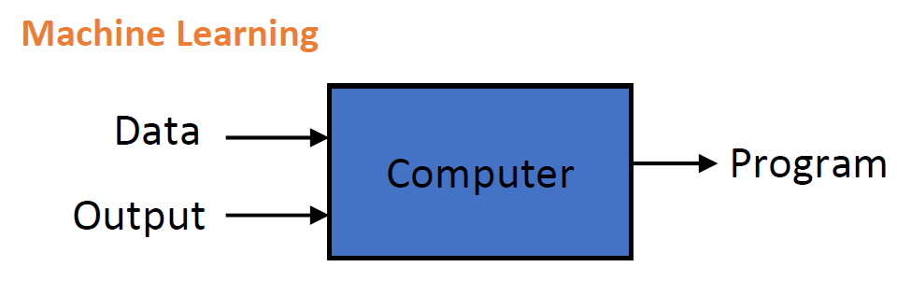
Machine Learning
Comment
Share
File
Edit
View
Insert
Runtime
Tools
Help
All changes saved
Code
Text
Connect
What is Learning?
$$\left\{x\right\}$$

Slide 4
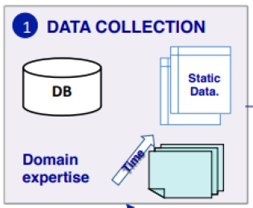
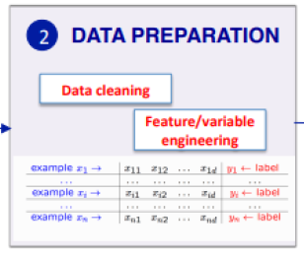
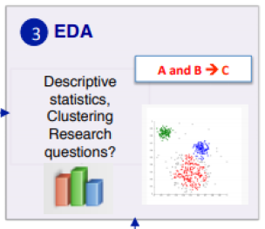
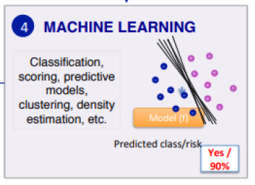
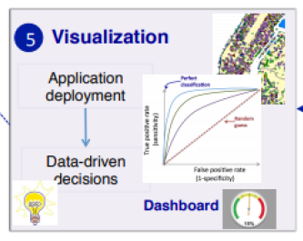
Machine Learning
Comment
Share
File
Edit
View
Insert
Runtime
Tools
Help
All changes saved
Code
Text
Connect
What is Learning?
$$\left\{x\right\}$$

Slide 5
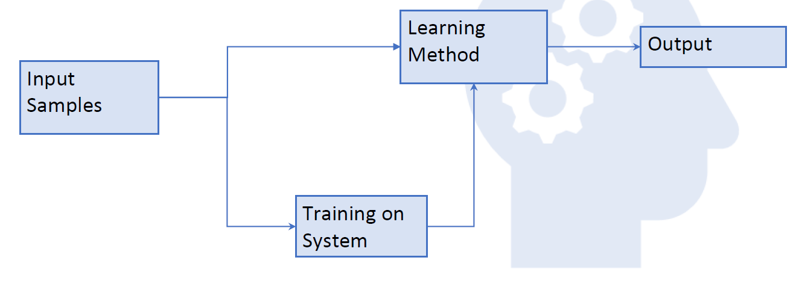
Machine Learning
Comment
Share
File
Edit
View
Insert
Runtime
Tools
Help
All changes saved
Code
Text
Connect
Learning System Model
$$\left\{x\right\}$$

Slide 6
Machine Learning
Comment
Share
File
Edit
View
Insert
Runtime
Tools
Help
All changes saved
Code
Text
Connect
Why is machine learning required?
$$\left\{x\right\}$$
Need for customization and personalization
Lack of human experts
Black-box human expertise
Rapidly changing phenomenon

Slide 7
Machine Learning
Comment
Share
File
Edit
View
Insert
Runtime
Tools
Help
All changes saved
Code
Text
Connect
A classic example of a task that requires machine learning: It is very hard to say what makes a 2
$$\left\{x\right\}$$

Slide 8
Machine Learning
Comment
Share
File
Edit
View
Insert
Runtime
Tools
Help
All changes saved
Code
Text
Connect
Some examples that machine learning solves
$$\left\{x\right\}$$
Recognizing Patterns - Excel
Facial identities or facial expressions
Hand written or spoken words
Medical images

Slide 9
Machine Learning
Comment
Share
File
Edit
View
Insert
Runtime
Tools
Help
All changes saved
Code
Text
Connect
Some examples that machine learning solves
$$\left\{x\right\}$$
Generating Patterns - Excel
Generating images or motion sequences

Slide 10
Machine Learning
Comment
Share
File
Edit
View
Insert
Runtime
Tools
Help
All changes saved
Code
Text
Connect
Some examples that machine learning solves
$$\left\{x\right\}$$
Recognizing anomalies - Excel
Unusual credit card transactions
Unusual patterns of sensor readings in a nuclear power plant

Slide 11
Machine Learning
Comment
Share
File
Edit
View
Insert
Runtime
Tools
Help
All changes saved
Code
Text
Connect
Some examples that machine learning solves
$$\left\{x\right\}$$
Prediction- Excel
Future stock prices or currency exchange rates

Slide 12
Types of Learning
C:\Users\> Supervised (inductive) learning –
Given: training data + desired output (labels)
C:\Users\>
C:\Users\>
C:\Users\> Unsupervised learning –
Given: training data (without desired outputs)
C:\Users\>
C:\Users\>
C:\Users\> Semi-supervised learning –
Given: training data + a few desired outputs
C:\Users\>
C:\Users\>
C:\Users\> Reinforcement learning –
Rewards from sequence of actions

Slide 13
Types of Learning
C:\Users\> Supervised (inductive) learning –
Given: training data + desired output (labels)
C:\Users\>
C:\Users\>
C:\Users\>

Slide 14
Types of Learning
C:\Users\> Unsupervised learning –
Given: training data (without desired outputs)
C:\Users\>
C:\Users\>
C:\Users\>

Slide 15
Types of Learning
C:\Users\> Semi-supervised learning –
Given: training data + a few desired outputs
C:\Users\>
C:\Users\>
C:\Users\>

Slide 16
Types of Learning
C:\Users\>
C:\Users\>
C:\Users\>
C:\Users\> Unsupervised Learning –
C:\Users\>
C:\Users\> Data has only input value and without target results

Slide 17
Types of Learning
C:\Users\>
C:\Users\>
C:\Users\>
C:\Users\> Unsupervised Learning –
C:\Users\>
C:\Users\> 1) The data has no target attribute.
C:\Users\> 2) We want to explore the data to find some intrinsic structures in them.

Slide 18
Types of Learning
C:\Users\>
C:\Users\>
C:\Users\>
C:\Users\> Clustering –
C:\Users\>
C:\Users\> Clustering is a technique for finding similarity groups in data, called clusters.
C:\Users\>
C:\Users\> It groups data instances that are similar to (near) each other in one cluster and data instances that are very different (far away) from each other into different clusters.

Slide 19



Types of Learning
C:\Users\>
C:\Users\>Clustering –
C:\Users\>
C:\Users\>
C:\Users\>

Slide 20
Types of Learning
C:\Users\>
C:\Users\>Clustering as unsupervised learning –
C:\Users\>
C:\Users\>
C:\Users\>
C:\Users\>
C:\Users\>
C:\Users\>
C:\Users\>
C:\Users\>
algorithm
Unlabeled data
algorithm
Structured data
Unlabeled data
New data (unlabeled)
assignment
New data included in structure

Slide 21
Types of Learning
C:\Users\> Clustering as unsupervised learning –
Think of it like this – In layman figures.
C:\Users\>
C:\Users\>
C:\Users\>

Slide 22








…
File
Edit
Selection
Search
Supervised.py
1
Supervised Learning
2
3
4
5
6
7
8
9
Data includes both the input and the desired results.

Slide 23
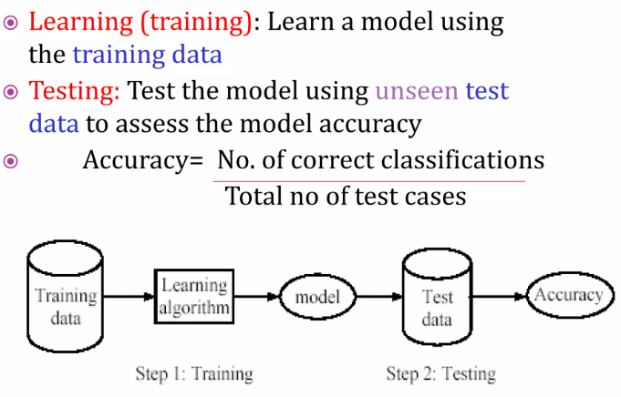
…
File
Edit
Selection
Search
Supervised.py
1
Supervised Learning Process: Two Steps
2
3
4
5
6
7
8
9

Slide 24
…
File
Edit
Selection
Search
Supervised.py
1
Think of the following examples.
2
3
4
5
6
7
8
9
An emergency room in a hospital measures 17 variables (e.g., blood pressure, age, etc) of newly admitted patients.
A decision is needed: whether to put a new patient in an intensive-care unit.
Due to the high cost of ICU, those patients who may survive less than a month are given higher priority.
Problem: to predict high-risk patients and discriminate them from low-risk patients.

Slide 25
…
File
Edit
Selection
Search
Supervised.py
1
Another example. .
2
3
4
5
6
7
8
9
•A credit card company receives lots of applications for new cards. Each application contains information about the applicant for the card,
age
Marital status
annual salary
location
outstanding debts
credit rating
Family information etc
•Problem: to decide whether an application should be approved or not approved.

Slide 26


…
File
Edit
Selection
Search
Supervised.py
Terms
1
2
3
4
5
6
7
8
9

Slide 27


…
File
Edit
Selection
Search
Supervised.py
Terms
1
2
3
4
5
6
7
8
9

Slide 28
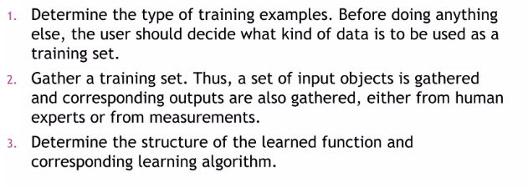
…
File
Edit
Selection
Search
Supervised.py
Supervised Learning Methodology
1
2
3
4
5
6
7
8
9

Slide 29
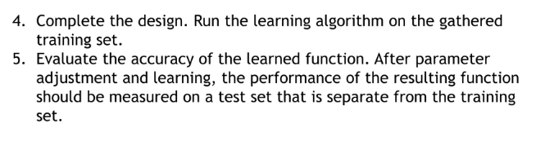
…
File
Edit
Selection
Search
Supervised.py
Supervised Learning Methodology
1
2
3
4
5
6
7
8
9

Slide 30
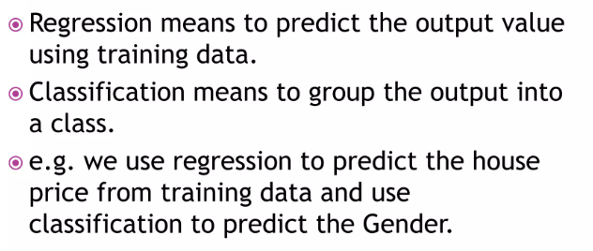
…
File
Edit
Selection
Search
Supervised.py
1: Classification
2: Regression
1
2
3
4
5
6
7
8
9

Slide 31
…
File
Edit
Selection
Search
Supervised.py
Classification Example: Spam Filter
1
Dear Sir.
First, I must solicit your confidence in this transaction, this is by virture of its nature as being utterly confidencial and top secret. …
2
3
4
5
6
7
8
9
Input: x = email
Output: y = “spam” or “ham”
Setup:
Get a large collection of example emails, each labeled “spam” or “ham”
Note: someone has to hand label all this data!
Want to learn to predict labels of new, future emails
Features: The attributes used to make the ham / spam decision
Words: FREE!
Text Patterns: $dd, CAPS
Non-text: SenderInContacts
…
TO BE REMOVED FROM FUTURE MAILINGS, SIMPLY REPLY TO THIS MESSAGE AND PUT "REMOVE" IN THE SUBJECT.
99 MILLION EMAIL ADDRESSES
FOR ONLY $99
Ok, I know this is blatantly OT but I'm beginning to go insane. Had an old Dell Dimension XPS sitting in the corner and decided to put it to use, I know it was working pre being stuck in the corner, but when I plugged it in, hit the power nothing happened.

Slide 32
…
File
Edit
Selection
Search
Supervised.py
Classification Example: Spam Filter
1
Dear Sir.
First, I must solicit your confidence in this transaction, this is by virture of its nature as being utterly confidencial and top secret. …
2
3
4
5
6
7
8
9
Input: x = email
Output: y = “spam” or “ham”
Setup:
Get a large collection of example emails, each labeled “spam” or “ham”
Note: someone has to hand label all this data!
Want to learn to predict labels of new, future emails
Features: The attributes used to make the ham / spam decision
Words: FREE!
Text Patterns: $dd, CAPS
Non-text: SenderInContacts
…
TO BE REMOVED FROM FUTURE MAILINGS, SIMPLY REPLY TO THIS MESSAGE AND PUT "REMOVE" IN THE SUBJECT.
99 MILLION EMAIL ADDRESSES
FOR ONLY $99
Ok, I know this is blatantly OT but I'm beginning to go insane. Had an old Dell Dimension XPS sitting in the corner and decided to put it to use, I know it was working pre being stuck in the corner, but when I plugged it in, hit the power nothing happened.

Slide 33
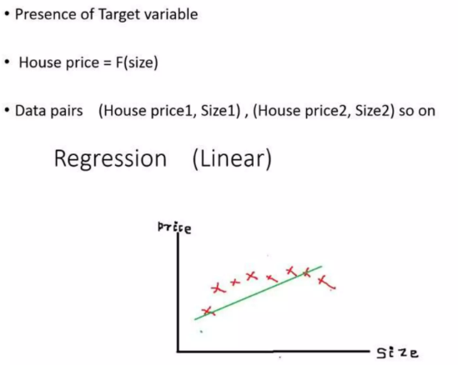
…
File
Edit
Selection
Search
Supervised.py
Regression Problem
1
2
3
4
5
6
7
8
9

Slide 34
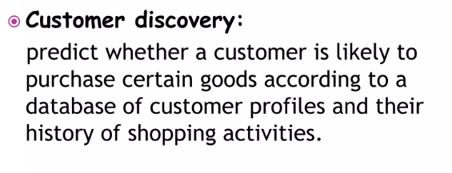
…
File
Edit
Selection
Search
Supervised.py
Examples of Supervised Learning
1
2
3
4
5
6
7
8
9

Slide 35
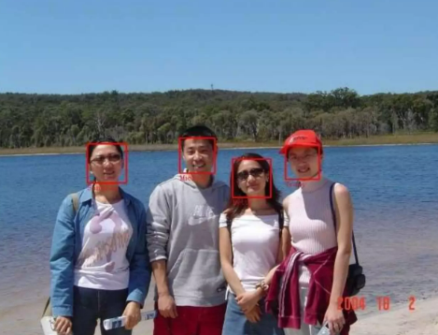
…
File
Edit
Selection
Search
Supervised.py
Examples of Supervised Learning
1
Face Detection:
Discriminating human faces from non faces
2
3
4
5
6
7
8
9

Slide 36
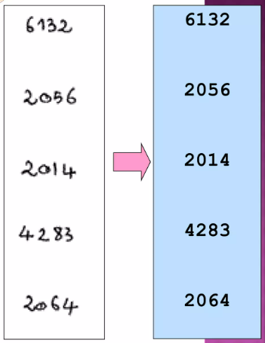
…
File
Edit
Selection
Search
Supervised.py
Examples of Supervised Learning
1
Character Recognition:
Identify handwritten characters: classify each image of character into one of 10 categories ‘0’, ‘1’, ‘2’.
2
3
4
5
6
7
8
9

